Slide 1
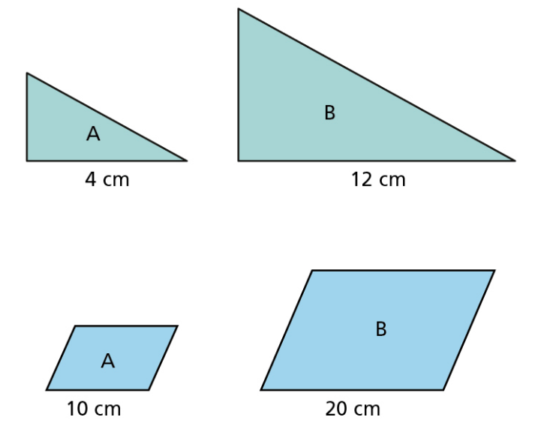
Scale Factors:
LISTEN

Slide 2
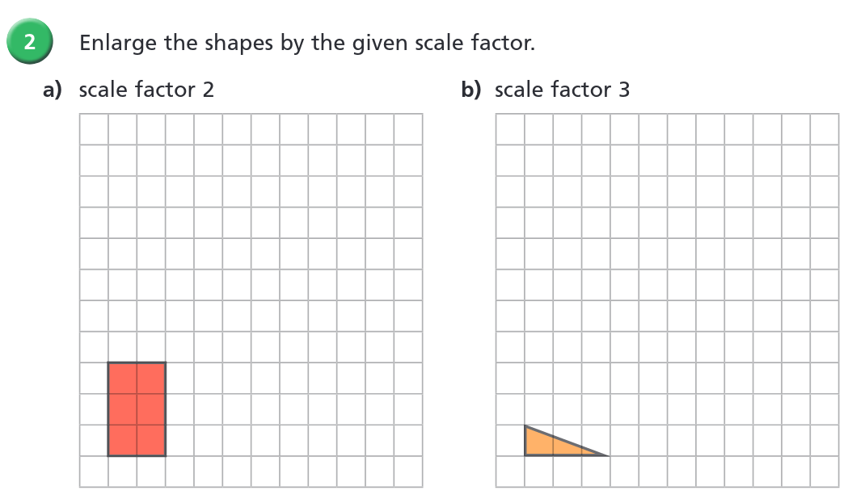
ACTIVITY

Slide 3
ANSWER

Slide 4
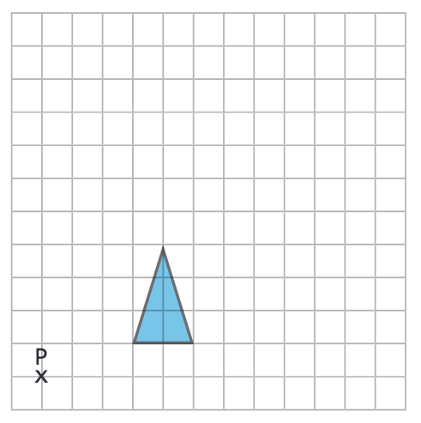
Enlarge the shape below by a scale factor of 2 using P as the center of enlargement
LISTEN

Slide 5
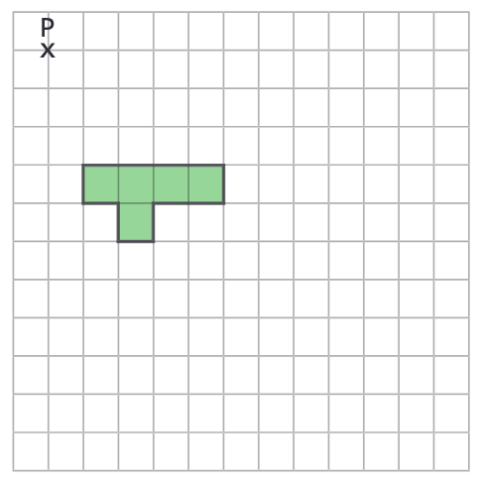
Enlarge the shape below by a scale factor of 2 using P as the center of enlargement. Draw the result in your books.
ACTIVITY

Slide 6

Enlarge the shape below by a scale factor of 2 using P as the center of enlargement. Draw the result in your books.
ANSWER

Slide 7
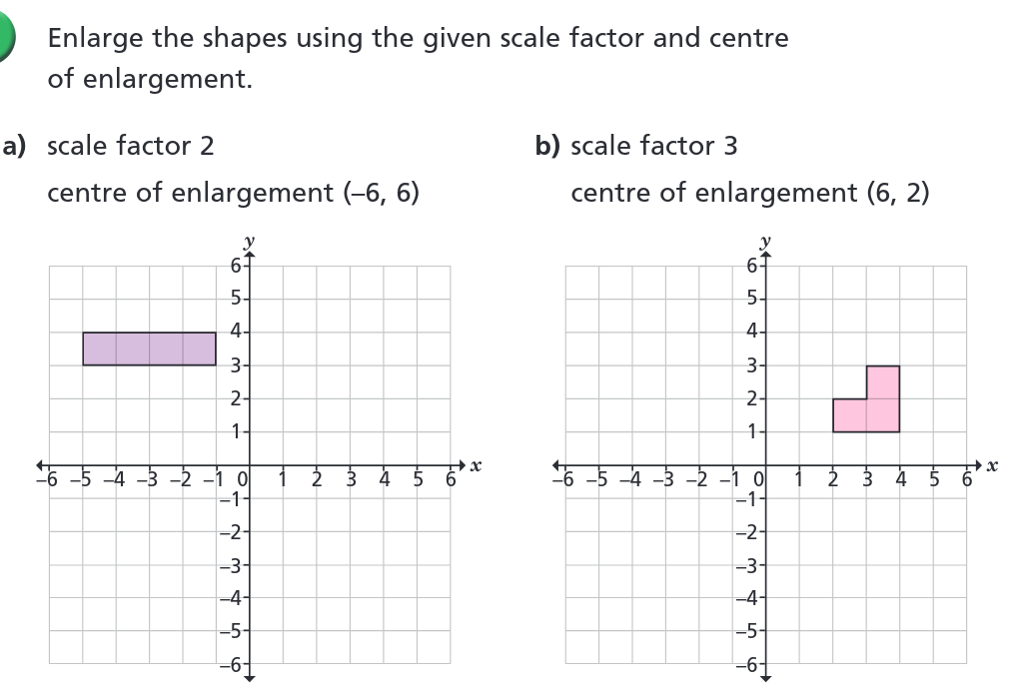
Draw the answers to each of the following in your books:
ACTIVITY

Slide 8
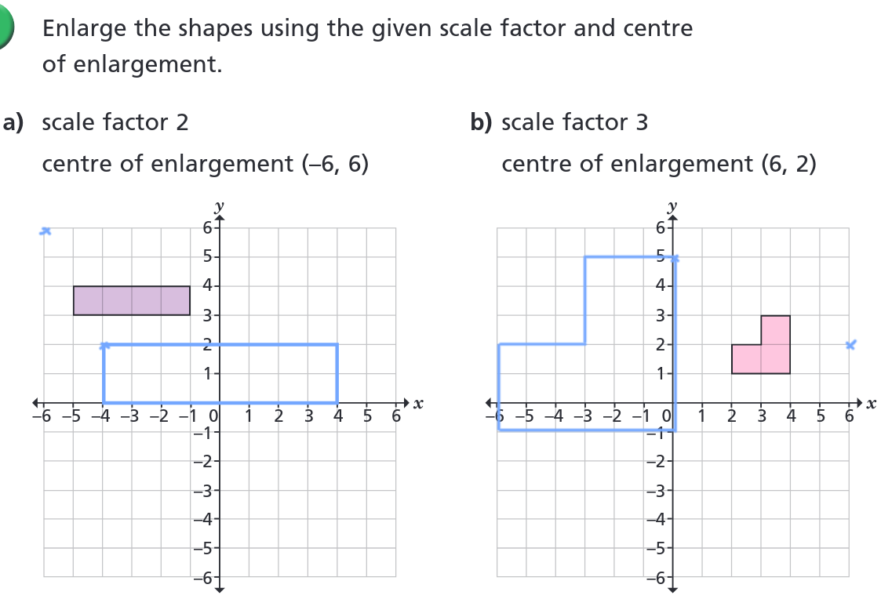
ANSWER

Slide 9
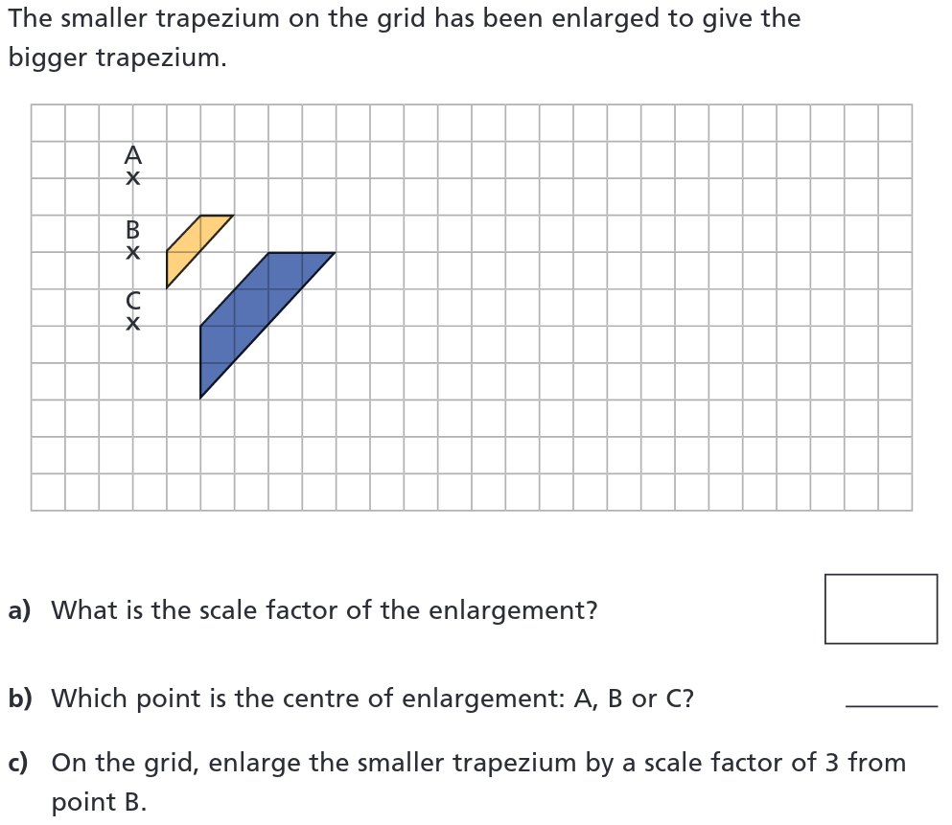
ACTIVITY

Slide 10
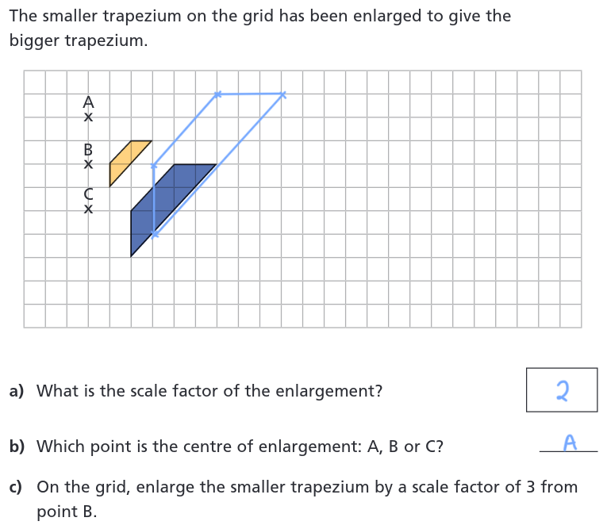
ACTIVITY

Slide 11
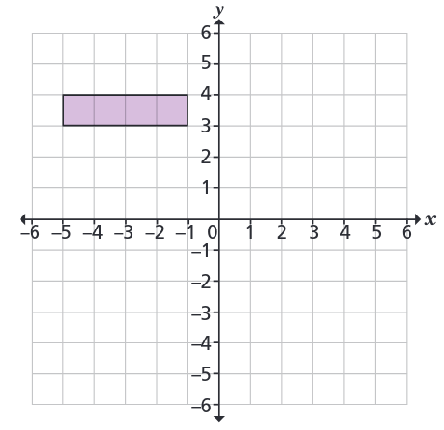
What about if we try to enlarge the shape below using:
A center of enlargement (0, 0)
A scale factor of -1??
DISCUSS

